Slide 1
Overview of Coaching Reports
v1 26/01/2018

Slide 2
About the Author
Created By: | Gauri Shevate
Credential Information: | Associate – CRM, EAS Salesforce
Version and Date: | V1, 19-Jan-2018, V2.0: July-2023:Updated with Lightning UI
Modified By: | Ritesh Kumar Prasad & Srijena,N

Slide 3

Objectives
After completing this chapter, you will learn to:
  Configure & Share a Coaching Report
  Explain User access for Reports
  Explain Life Cycle of Coaching report
  Create Coaching report

Slide 4
Recap ...
In the previous Module - DCR Configuration, you learnt to:
  Describe DCR
  Create new DCR
  Describe DCR Process
  Describe DCR Model
And now ...

Slide 5

Do You Know
Coaching Report is used for feedback and mentoring between Managers and Sales Representatives
Managers are able to edit reports they created because they are above employees in the Role Hierarchy
Advanced Sharing requires the use of the MC Engine

Slide 6
Introduction to Coaching Reports

Slide 7
Introduction to Coaching Reports
The Coaching Report object enables a customer to create targeted forms for coaching and mentoring between Managers and Sales Representatives
Completion of a Coaching Report form can be addressed after the ride along is complete to provide an evaluation and constructive feedback
Online, the Coaching Reports are printable using Salesforce’s standard Printable View link on the top-right hand side of the page

Slide 8
Configuring & Sharing a Coaching Report

Slide 9
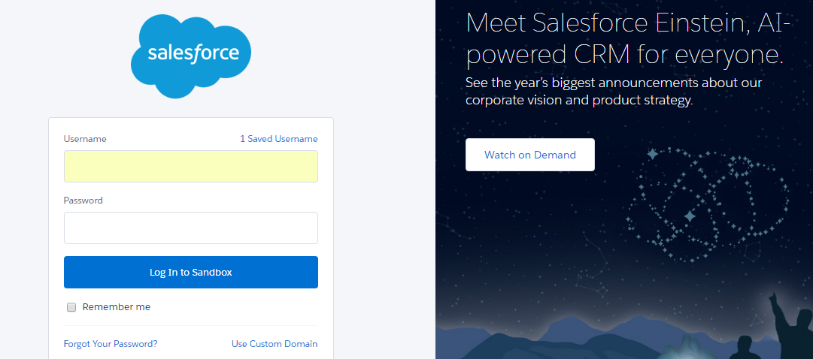
VEEVA CRM Login
Login to VEEVA Application:
Similar to Salesforce.com CRM, VEEVA CRM can be accessed from Production and Sandbox environments. Standard login URL formats apply
  https://login.salesforce.com – Production
  https://test.salesforce.com – Sandbox

Slide 10
Configuring Coaching Report ... 1
You must login as an VEEVA admin to configure Coaching Reports for desired User Group (Manager, Salesrep)
All Metadata configuration is done through VEEVA CRM online application Setup Console
  Navigation: Login to VEEVA CRM as Administrator > Admin User > Setup
When configuring Coaching Reports, ensure the user has at least read-only permissions to at least one of the following fields on the Coaching Report object:
Manager_vod
Employee_vod
Status_vod
Review_Date_vod

Slide 11
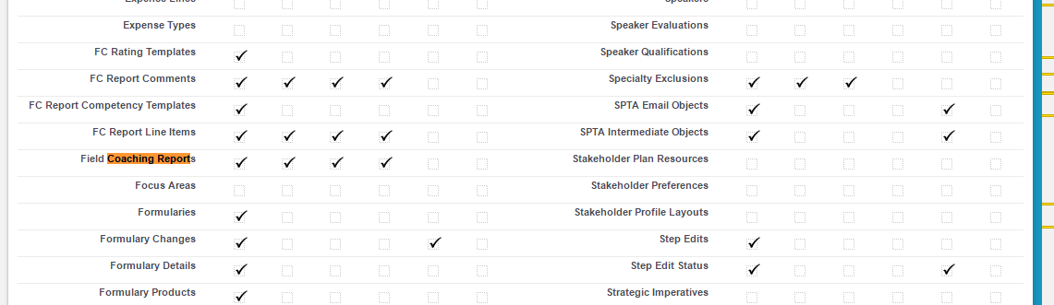
Configuring Coaching Report ... 2
Object Level Permission can be given as following

Slide 12
Configuring Coaching Report ... 3
The user must also have read permission for the Coaching Reports_vod object
To configure Coaching Reports for Windows 8, enable the Coaching Reports VMOC. After the user syncs the device, the Coaching Reports display in the top application bar
As an VEEVA admin we can create various custom fields in coaching report object as per requirement
The Read and Edit privileges are controlled by standard Salesforce CRUD access based on the user’s profile
Manager profile has standard Salesforce CRUD access and Salesrep profile has Read and Edit access

Slide 13
Sharing of Coaching Reports
To share reports between managers and Sales Reps, when creating the coaching report record, the owner of the record is switched to the employee being reviewed (this is done via a delivered trigger)
The Sharing happens through the Org’s role hierarchy
The owner of the record will have read-only privileges, allowing the employee to view reports that were filled out by his manager, but not edit them
Managers are able to edit reports they created because they are above employees in the Role Hierarchy

Slide 14
User access for Reports

Slide 15
Different Users ... 1
Designer – this is the business analyst or operations person who actually creates the Coaching Report and the questions
Coach (Share Team) – these are the managers who populate the information in the Coaching Report
    Has visibility to the Coaching Report templates
    Has permission to create Coaching Reports for Employees. Fills out a number of fields on the Coaching Report header
    Review Date(optional) – Date the Coaching Report was completed in the field
    Any number of custom fields that are on the layout
    Fills out the Coaching Report questions
    Saves the report, or once complete, sends to the employee

Slide 16
Different Users ... 2
Employee – these are the sales reps who receive the Coaching Report
  Has read-only access to the Coaching Report questions and header fields
  Is below the Coach's position in the role hierarchy
  Has the ability to acknowledge the report and completing the report by selecting the ‘Complete’ button
  Once the employee acknowledges the receipt of the Coaching Report, the report’s lifecycle is complete

Slide 17
Lifecycle of Coaching report

Slide 18
Lifecycle of Coaching Report
Business Admin creates Coaching Report and assigns to set of Coaches
Coach Fills out Coaching Report on behalf of Employee and sends to Employee for Review
Employee receives, reviews and officially acknowledges the report

Slide 19
Creation of a Coaching report

Slide 20
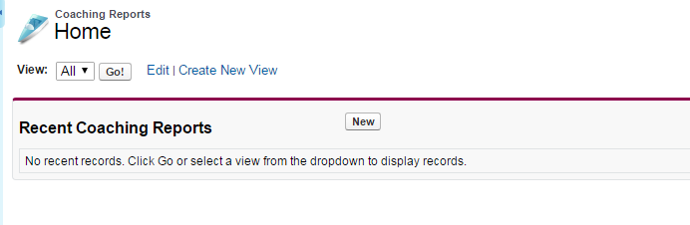
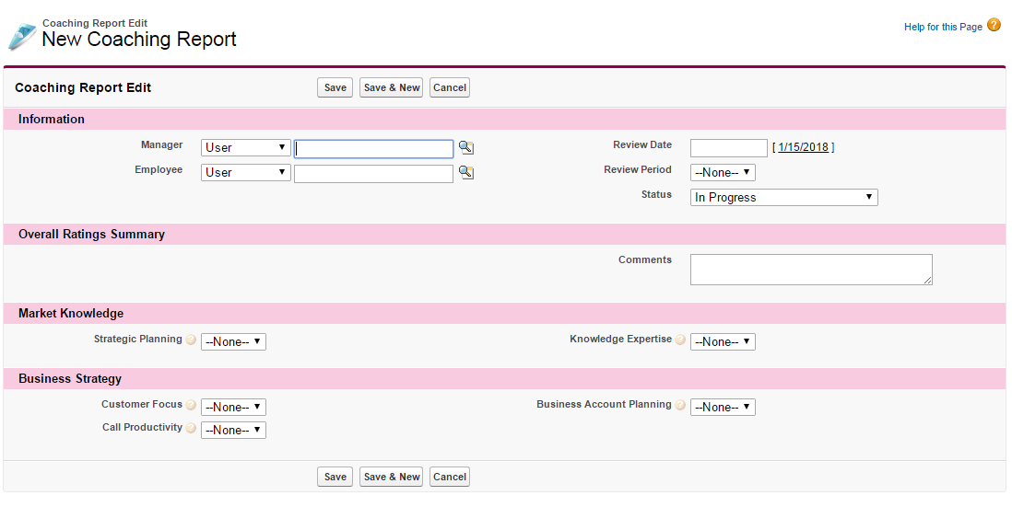
New Coaching Report Creation ... 1
New Coaching Report is created by clicking on “New” button inside of Coaching Report Tab
All Fields including Manage and Employee are populated with data and then it is saved

Slide 21
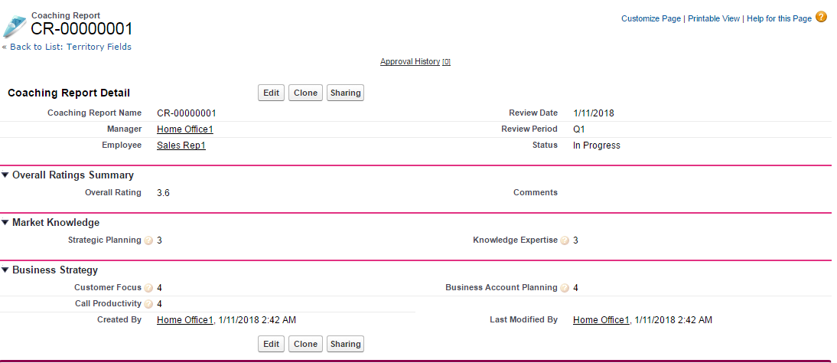
New Coaching Report Creation ... 2
Once details are filled and Report is saved it is having status as In-Progress
Created Coaching Report can be cloned and shared

Slide 22
Check Your Understanding ... 1
1. Which access permission does the Manager of the FCR has?
Read only
Edit
Read/Edit/Create
Answer: Read/Edit/Create
© Cognizant 2015

Slide 23
Check Your Understanding ... 2
2. To configure Coaching Reports for Windows 8, enable the Coaching Reports VMOC.
State True or False
True
False
Answer: True
© Cognizant 2015

Slide 24
Check Your Understanding ... 3
3. Employee are the sales reps who receive the Coaching Report.
State True or False
True
False
Answer: True
© Cognizant 2015

Slide 25
Check Your Understanding ... 4
4. The Sharing of Coaching Report happens through the Org’s _____ hierarchy.
Role
Territory
Answer: Role
© Cognizant 2015

Slide 26
Check Your Understanding ... 5
5. All Metadata configuration is done through VEEVA CRM online application Setup Console.
State True or False
True
False
Answer: True
© Cognizant 2015

Slide 27

Summary
In this module, you have learnt to:
  Configure & Share a Coaching Report
  Explain User access for Reports
  Create Coaching report

Slide 28

Source
https://crmhelp.VEEVA.com/doc/Content/Home.htm
Disclaimer: Parts of the content of this course is based on the materials available from the Web sites and books listed above. The materials that can be accessed from linked sites are not maintained by Cognizant Academy and we are not responsible for the contents thereof. All trademarks, service marks, and trade names in this course are the marks of the respective owner(s).

Slide 29
Coming Next ...
In the upcoming module - Survey Management, you will learn to:
  Describe and Create survey life cycle
  Describe Survey Management Page
  Describe Data Model
© Cognizant 2015
28

Slide 30
Thank You!
  You have successfully completed
  Overview of Coaching Reports

